Slide 1

A Plankton Classifier Chatbot using SAP’s Conversational AI and Transfer Learning
Mouelhi Aymen, SAP
April 10, 2019

Slide 2
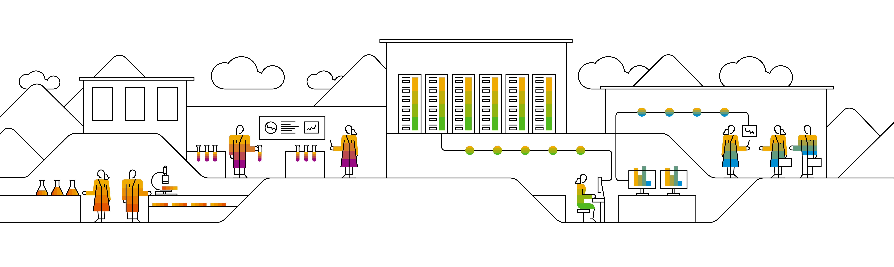
Key Concepts

Slide 3












Key concepts #1 What’s a bot?
A bot is a program that automatize a task. Through messaging channels clients make a request. The bot understands and executes.

Slide 4
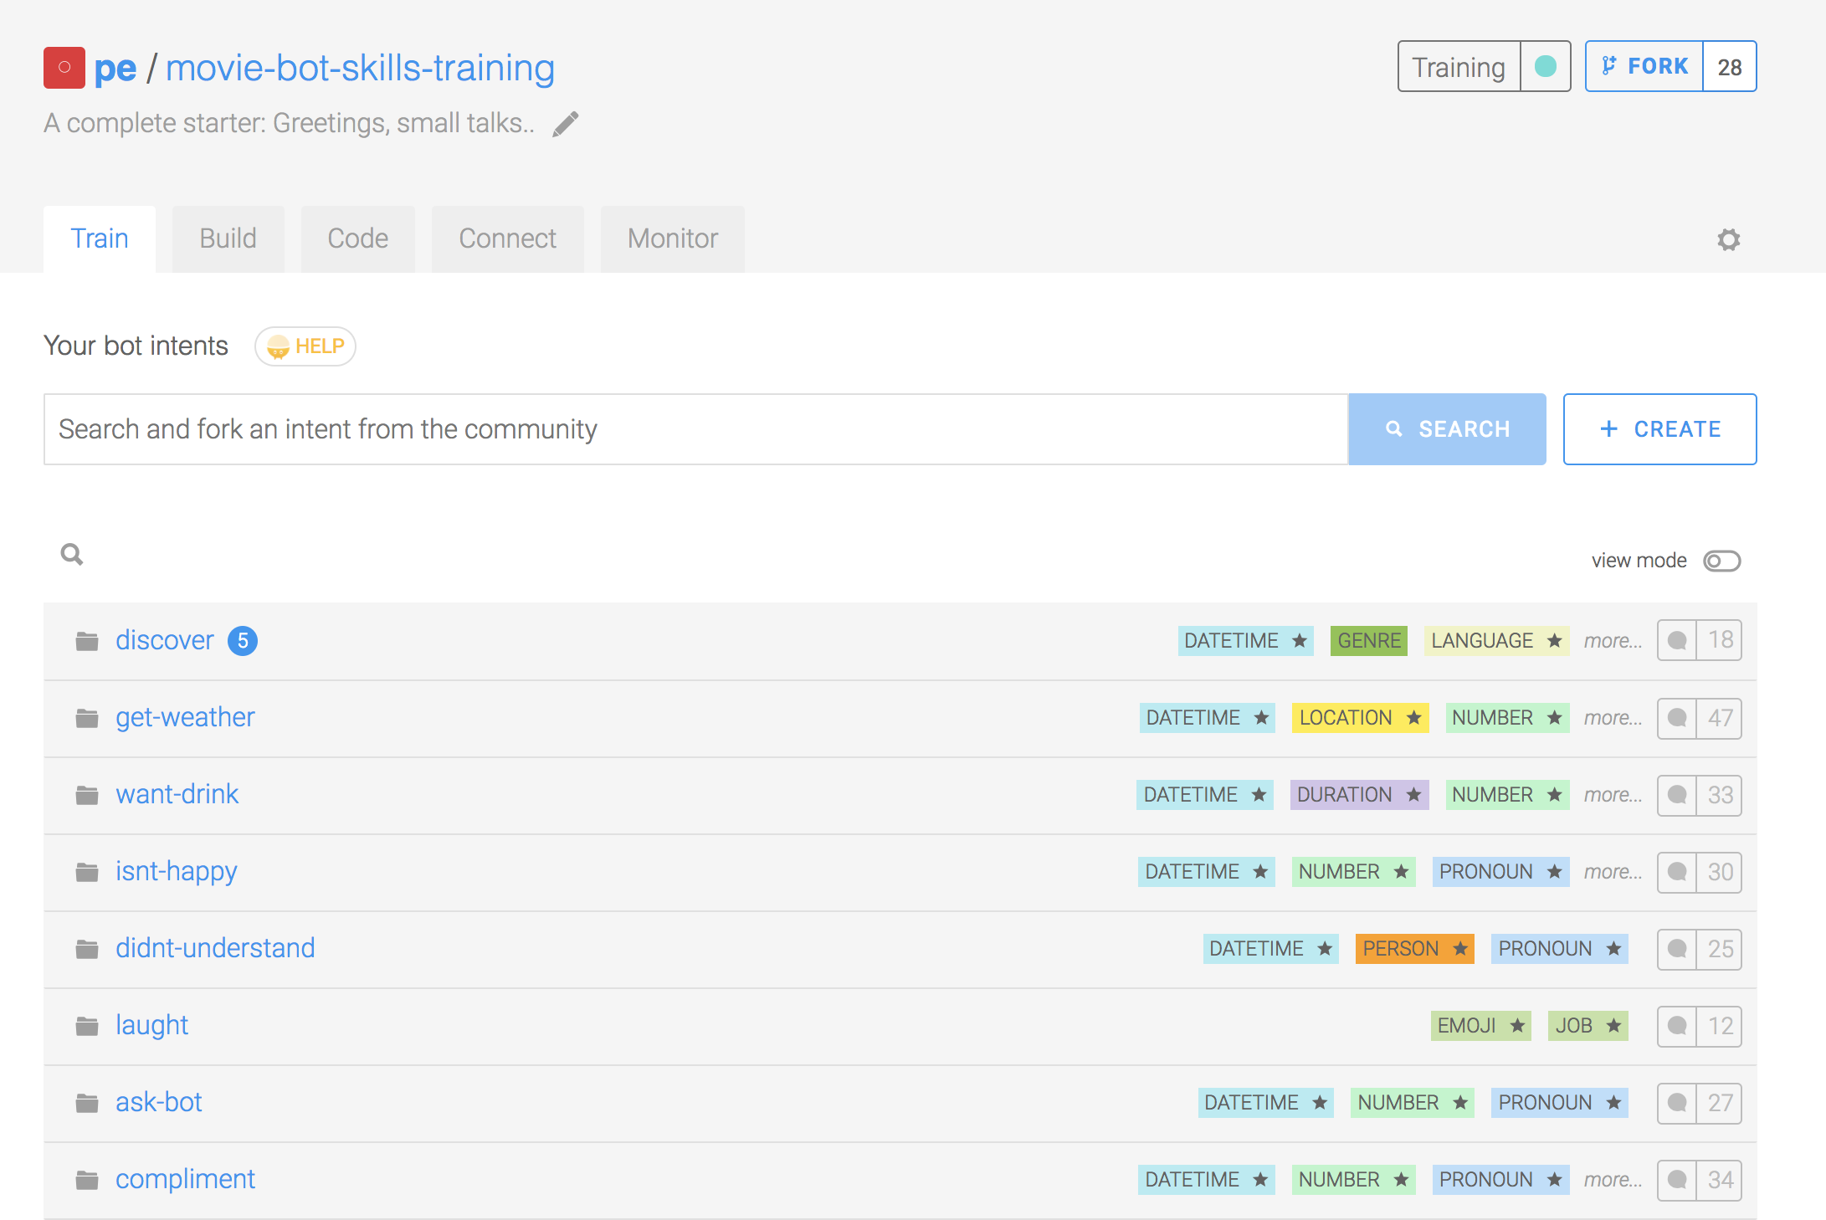
Key concepts #2 NLP – Intents, expressions & entities
An intent is a box of expressions that mean the same thing but are constructed in different ways. Each one of your intents represents an idea your bot is able to understand.
A bot is made of intents

Slide 5
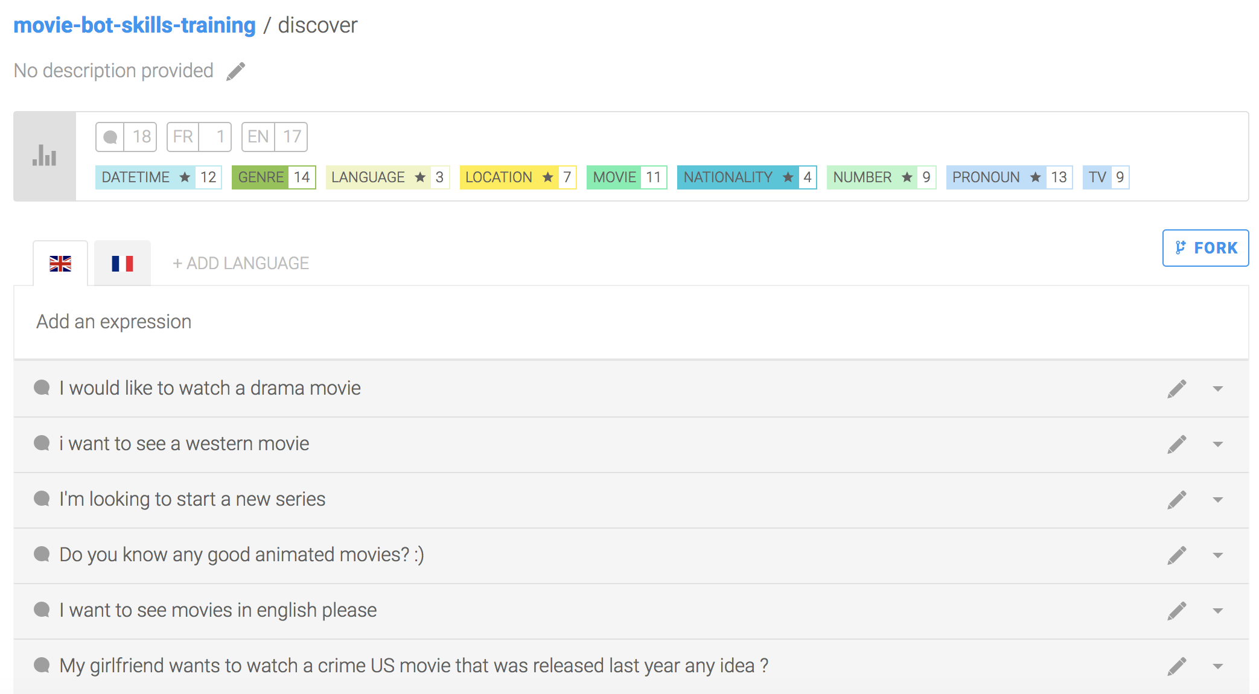
Key concepts #2 NLP – Intents, expressions & entities
An expression is a sentence your bot can understand: basically your users’ inputs. Expressions are organized in intents and constitute the entire knowledge of your bot.
Every intent is trained with expressions

Slide 6
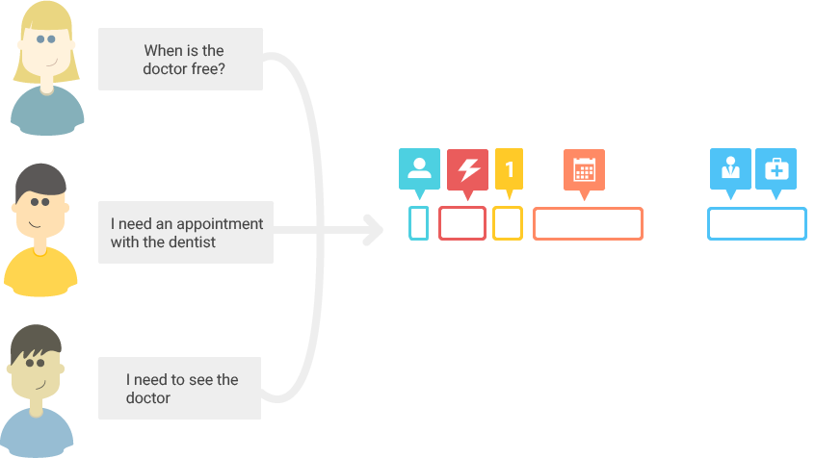
Key concepts #2 NLP – Intents, expressions & entities
I want to watch a movie
Any good western tonight?
I want to start a new show!
greetings
discover-movie
weather
INTENT
The more expressions you have, the more precisely your bot will be able to understand its users. The aim is to detect in which intent box an expression the bot has never seen is.

Slide 7
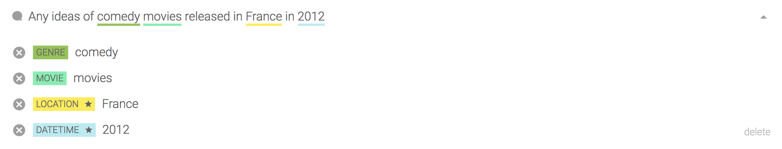
Key concepts #2 NLP – Intents, expressions & entities
An entity is a keyword extracted from an expression. We detect automatically 31 different entities such as datetimes, names, locations, etc.
Entities are extracted from each expression

Slide 8




Key concepts #2 NLP – Intents, expressions & entities
1
EXTRACTION
2
ENRICHMENT
"datetime": [ {
"formatted": "Sunday, 01 January 2012 at 12:00:00 AM (+0000)", "iso": "2012-01-01T00:00:00+00:00", "raw": "in 2012" } ]
3
NORMALISATION

Slide 9
Key concepts #2 NLP – Intents, expressions & entities
Entities with a black star next to them are called Gold entities they are automatically detected and extracted. But you are not limited to these Gold entities: you can also tag your own custom entities to detect keywords depending on your bot's context, such as movie genres if you are building a movie bot.

Slide 10
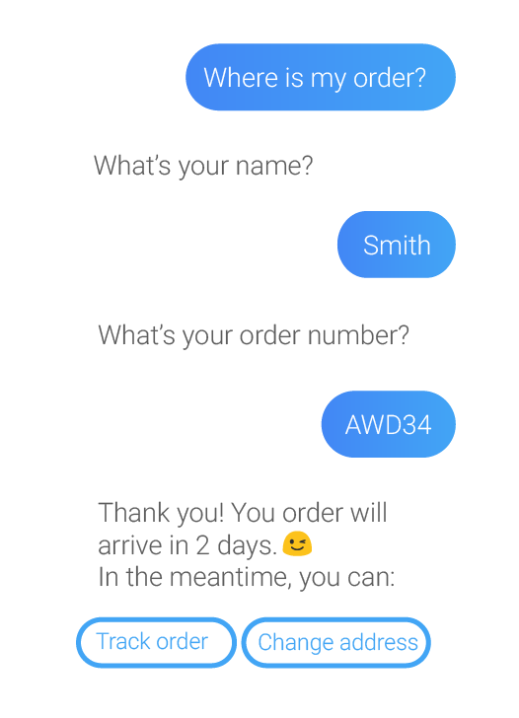
Key concepts #3 Conversation - Skills
A bot conversation is made of Skills.
A skill defines a specific block of conversation that has a clear purpose.
A skill can be as simple as the ability to greet someone, but it can also be more complex, for example giving movie suggestions based on information provided by the user.

Slide 11
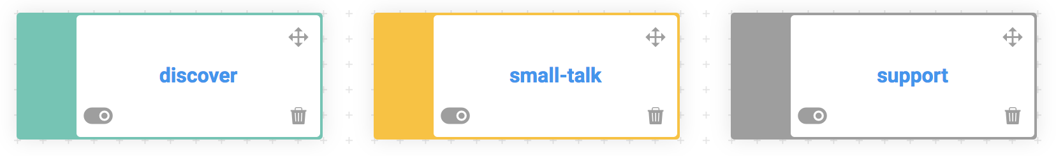
Key concepts #3 Conversation - Skills
Closely linked to the core purpose of your bot
Small talk and non-core related questions
Will be triggered automatically if no other skills is
Business
Floating
Fallback

Slide 12
Key concepts #3 Conversation - Skills
Triggers
Conditions determining if the skill should or shouldn't be activated
Requirements
Determining the information the bot needs to retrieve from the user, and how to retrieve it
Actions
Performed by the bot when all requirements are complete (for example, send a message)

Slide 13
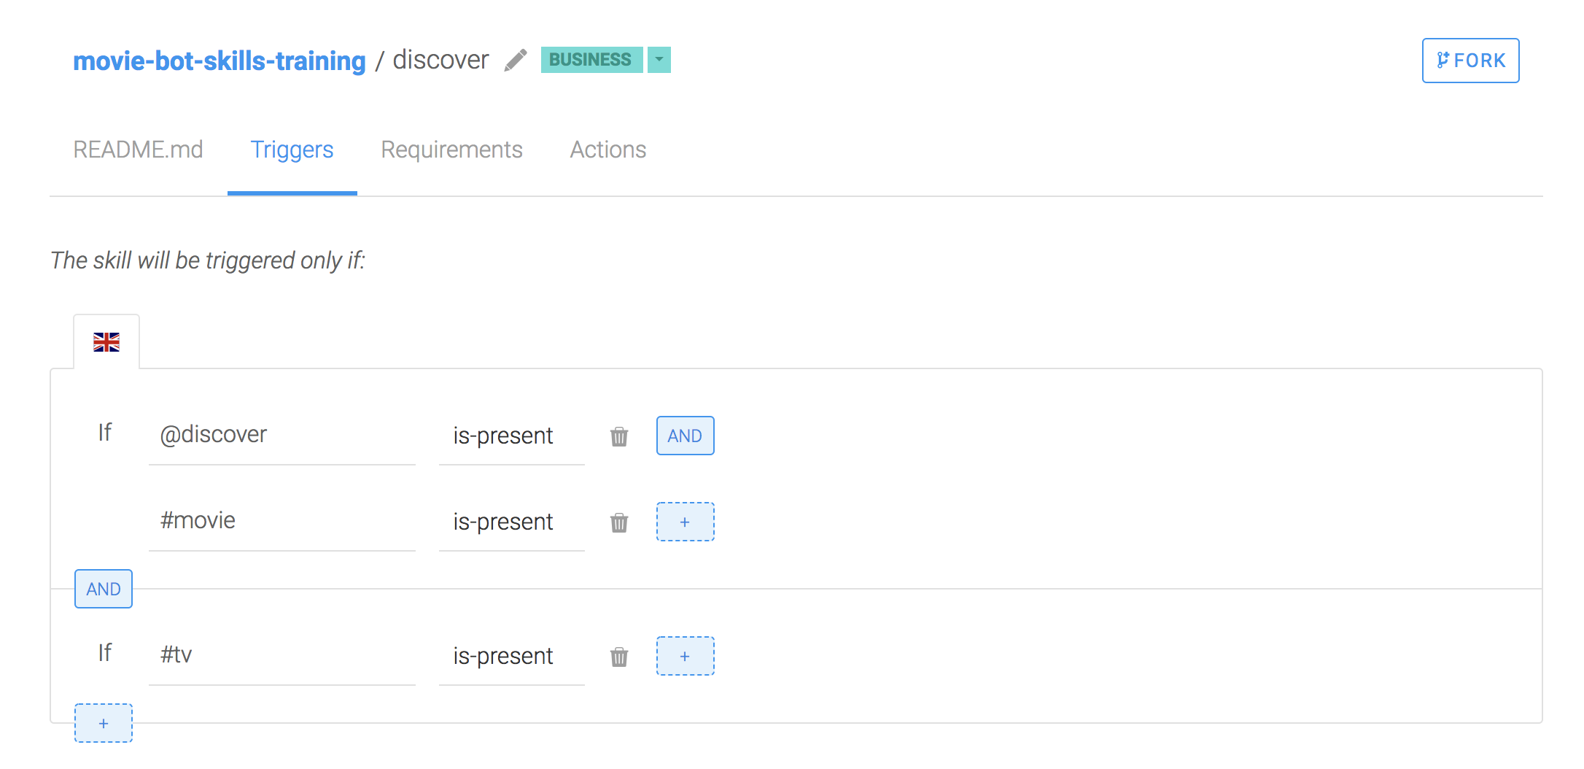
Key concepts #3 Conversation - Skills
Conditions define tests that will either be true or false. You will find conditions in different parts of your skill: triggers, requirements and in each message group in actions.
Skills have conditions

Slide 14
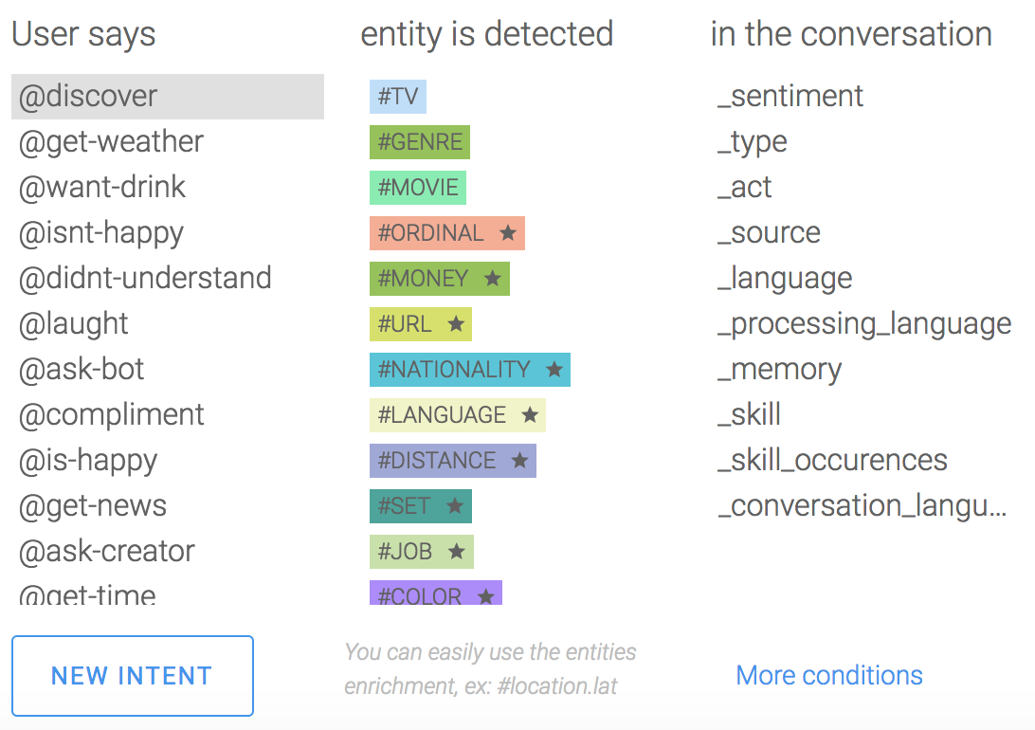
Key concepts #3 Conversation - Skills
Inside your data conditions, you will find a list of operands.
@ means intent
# means entity
_ means NLP attribute
Conditions have operands

Slide 15
Key concepts In summary…
Intents
Entities
Skills
To summarize a bot is made of intents that are made of expressions that contain entities. Intents and entities are used by Skills to manage conversation

Slide 16
Bot monitoring – Log feed
Log feed allows you to monitor and train your bot :
Assign new intent
Tag entity
It is possible to see or extract (csv) based on:​
A specific period​
Matching strictness
Language
One or many intents
​
Combining filters is possible

Slide 17
Bot monitoring – Usage analytics
Usage Metrics allows you to follow:
Number of users and conversations
Popular skills / intents / entities
Skills / intents / entities usage
-> based on a specific period if needed

Slide 18
Thank you.
Contact information:
Aymen Mouelhi
Data Scientist
aymen.mouelhi@sap.com

